Slide 1
Online Library Website
Course: Full Stack Java Developer
Trainer Name: Priya
Presentation Date: 22/12/23
Author: Josh

Slide 2
Project Objective
Contents
Project Deliverables
OBJECTIVES
Improve efficiency in library operations.
Enhance user experience for both staff and library patrons.
Provide accurate and real-time information on library resources.
Project Objective
Deliverables
Project Environment
Tools
Project Design
Classes & Methods
Screenshots
UAT Tests Cases
Project Outcome
Improvements
Project Success Criteria:
The system meets all functional and non-functional requirements.
The system is successfully deployed and used by librarians, students, and faculty members.
The system receives positive feedback from users regarding its ease of use and functionality.
The system demonstrates improved efficiency in library management operations.
Proposed Solution
PURPOSE
A new library housed inside a private residence is started. It currently has 2 staff is in process of stocking books. The library has WIFI facilities and is open to a resident size of 250. It is not open to public. As the facilities is still very new, less then 10% of residence have registered as library member. Members, books volume is expected to increase as more complete their renovation and start to move in to premise. More librarians will also be hired along the way.
The purpose of this Library Management System (LMS) is to streamline the processes involved in managing a library's resources, including books, periodicals, and user information.

Slide 3
Implementation
Staff module is accessible by library manager to add, modify or delete library staff records
Books module is accessible by library staff for purpose of knowing where is physical book placed and to replenish
A few terminals will be setup for members to browse books menu

Slide 4
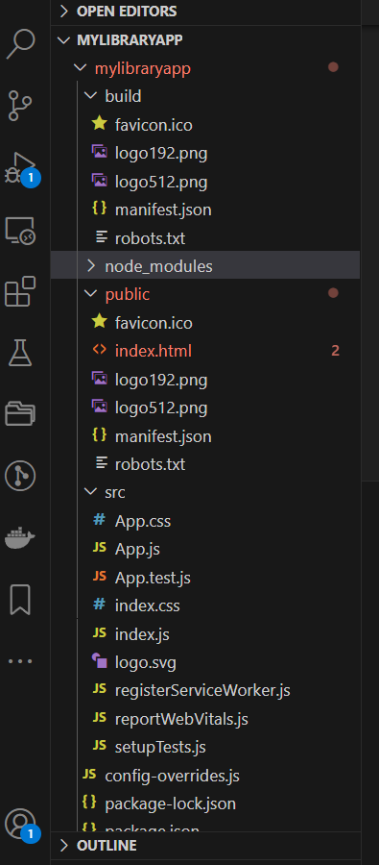
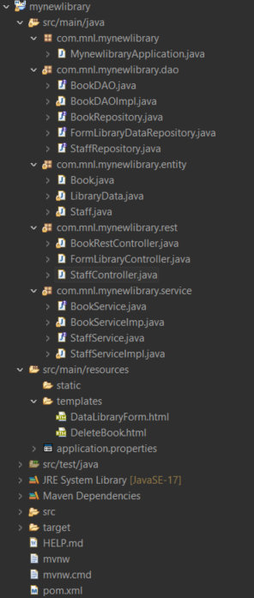
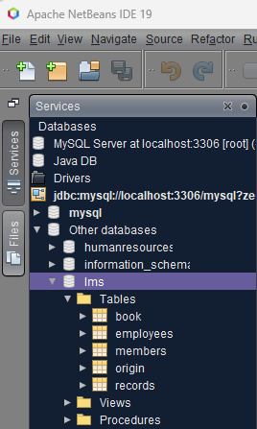
Technical Environment and Tools Used
Visual Studio Code
Technology
Java 17 / 11 / 8
Spring Boot 3 / 2 (with Spring Web MVC, Spring Data JPA)
MySQL
Maven
PROJECT DELIVERABLES
BACKEND
Spring Boot application with RESTful APIs
Database schema and data migration scripts
Unit tests for backend components
FRONTEND
ReactJS application with user interface components
Routing and navigation between different pages
Integration with backend APIs for data fetching and manipulation
Netbeans
Eclipse project directory structure

Slide 5
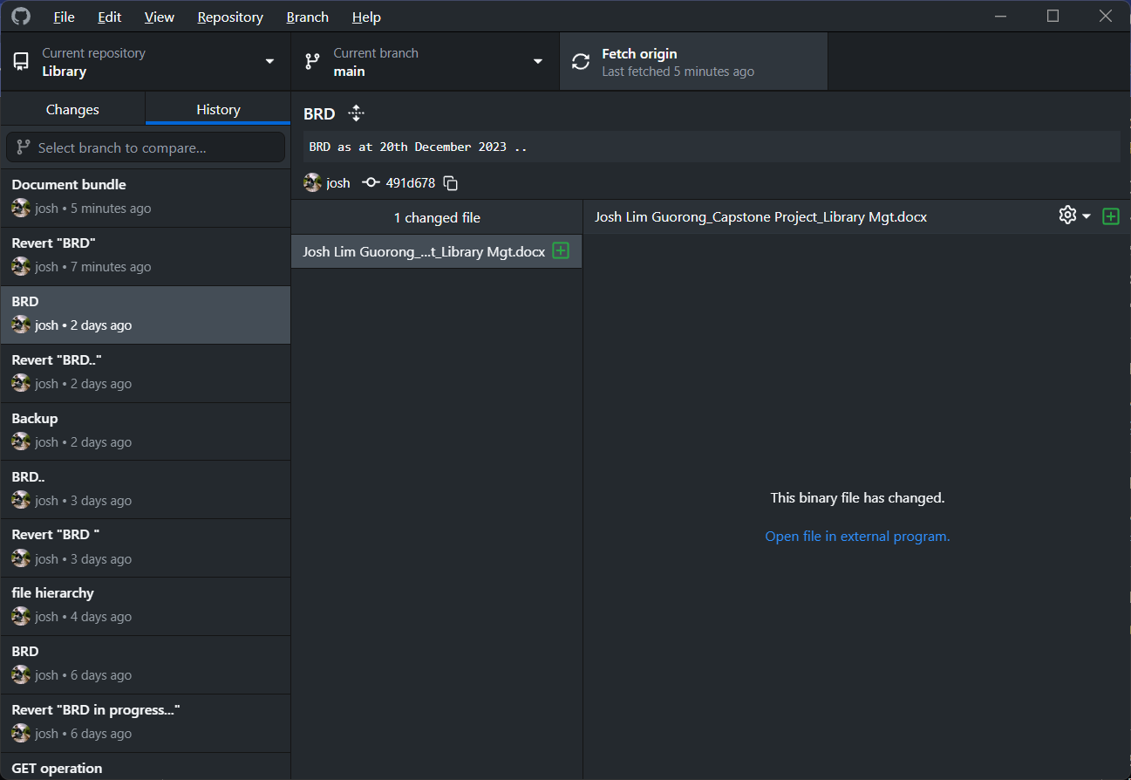
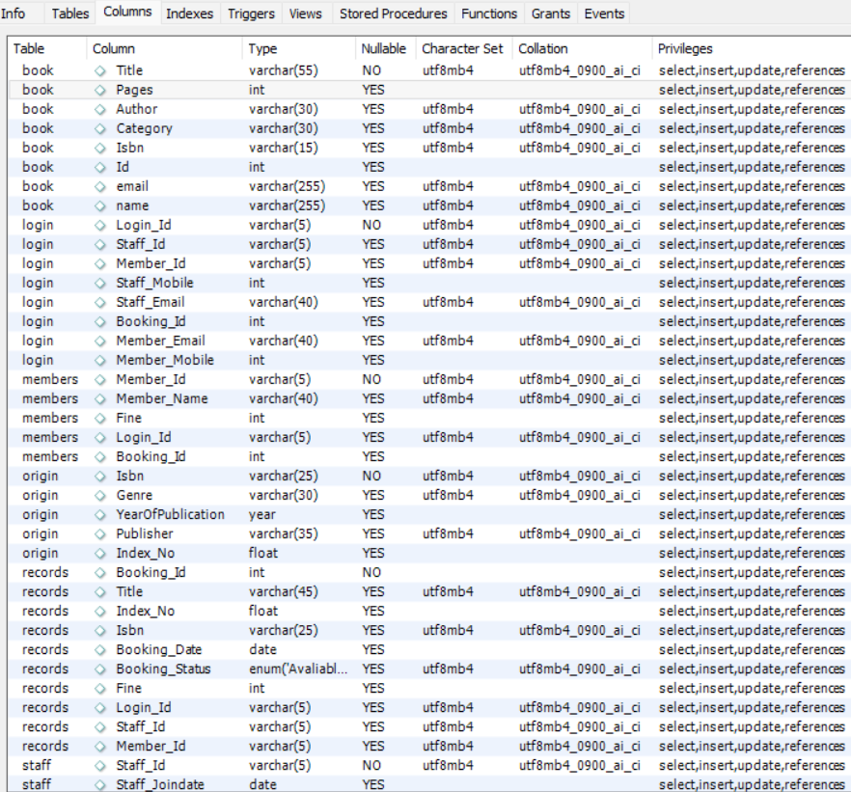
Github version control
MySQL – Column Table

Slide 6
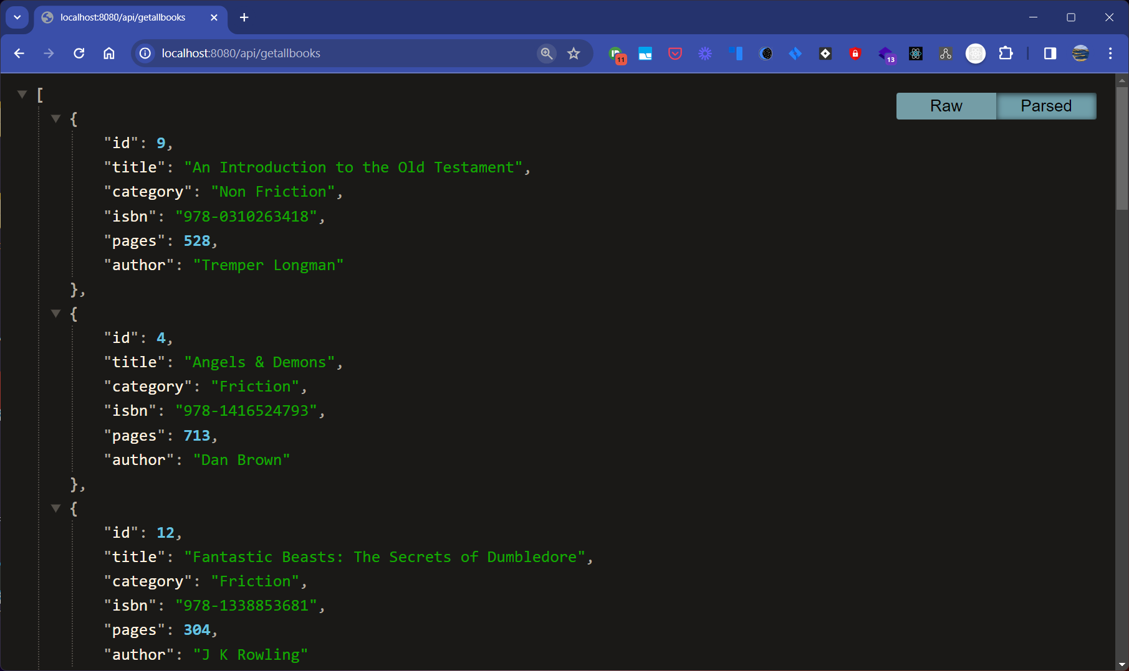
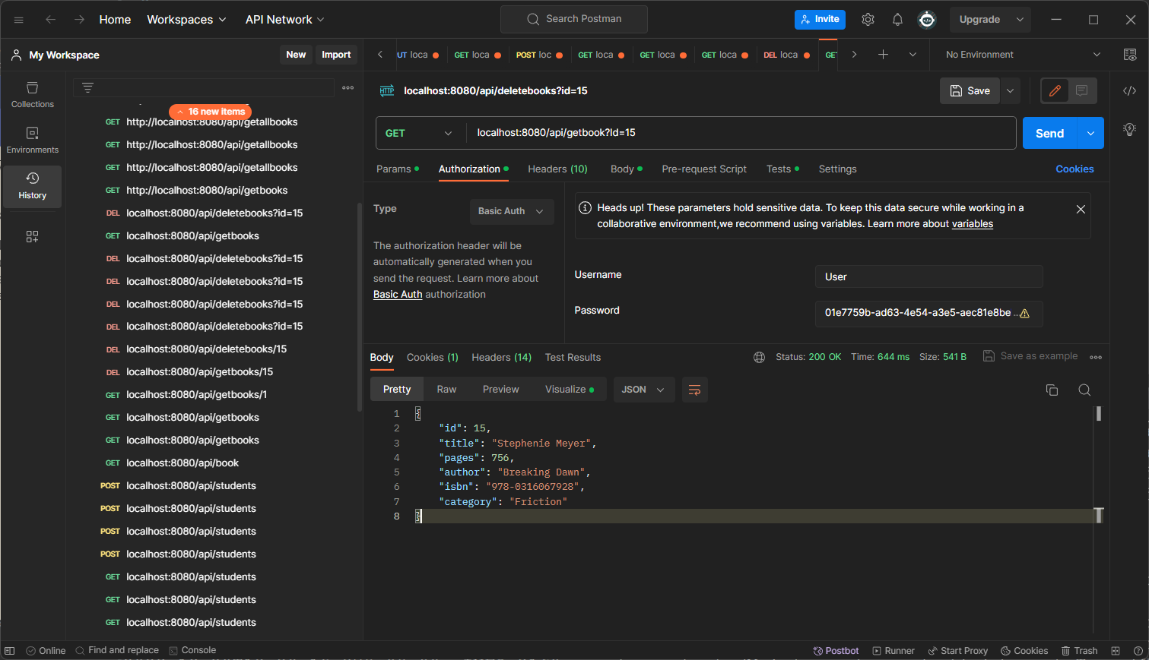
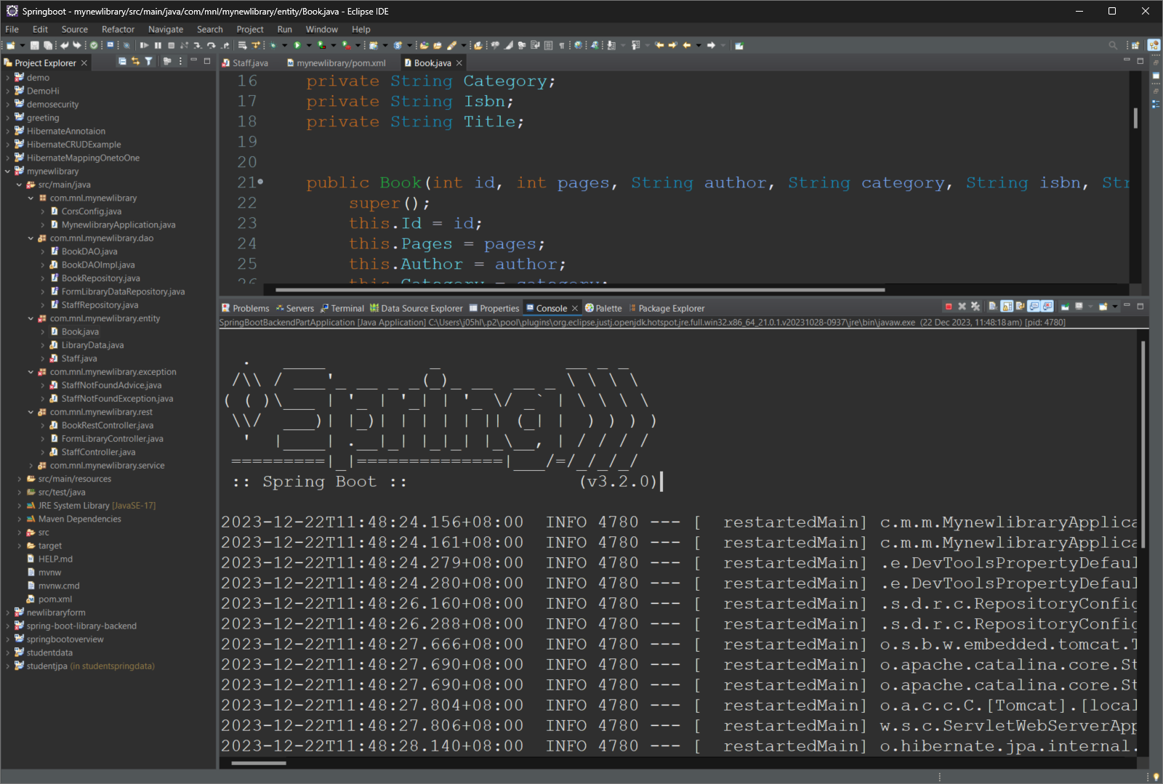
JSON
Spring boot
Postman

Slide 7
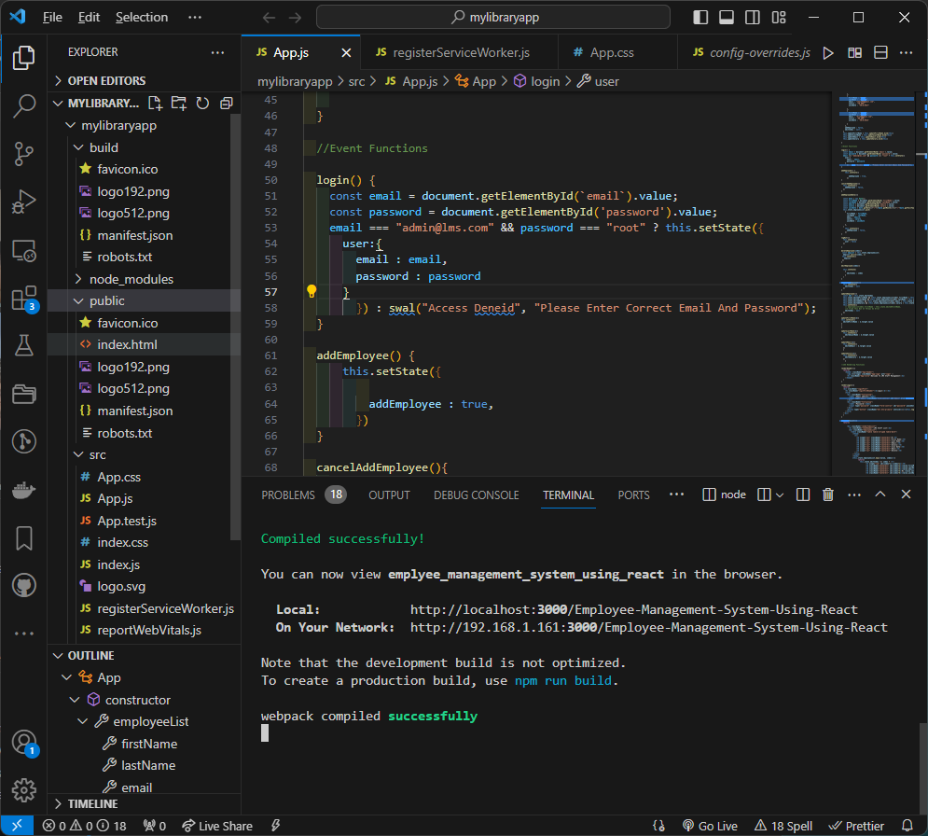
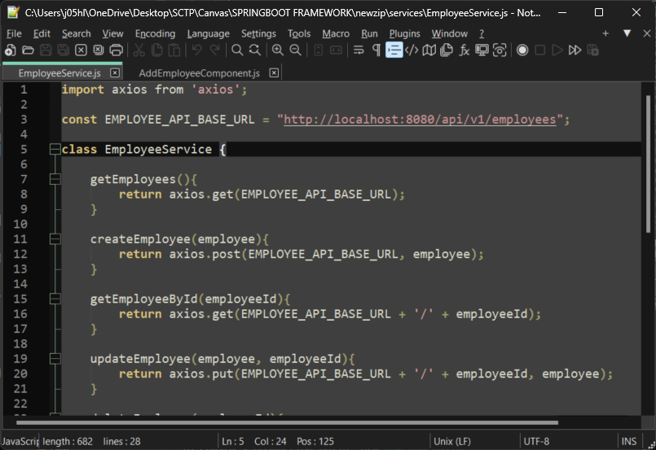
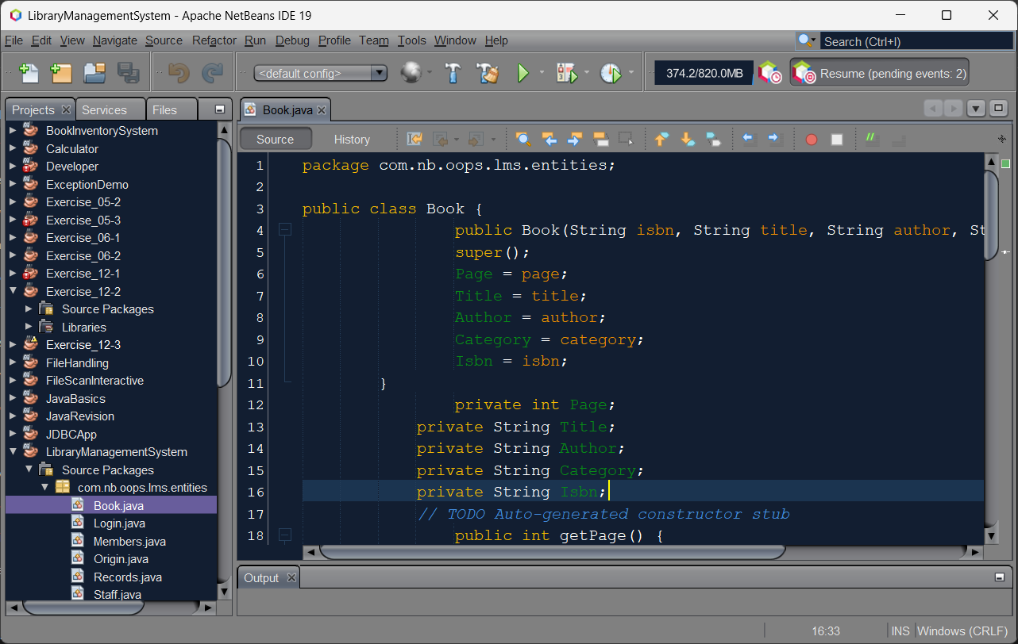

Slide 8
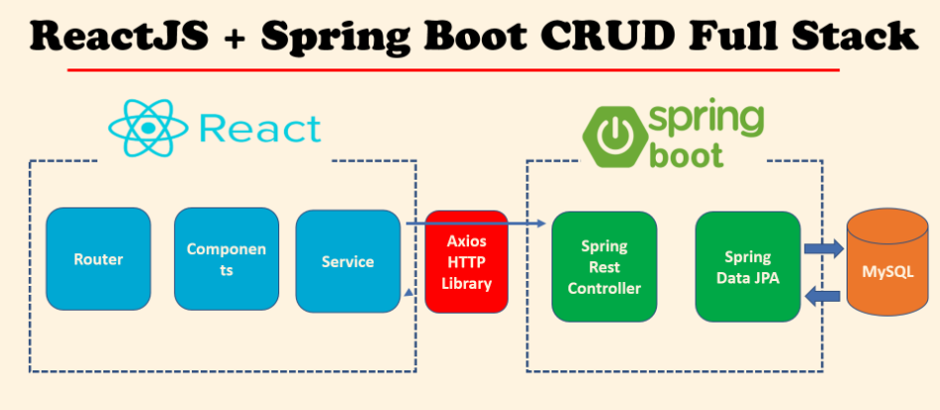
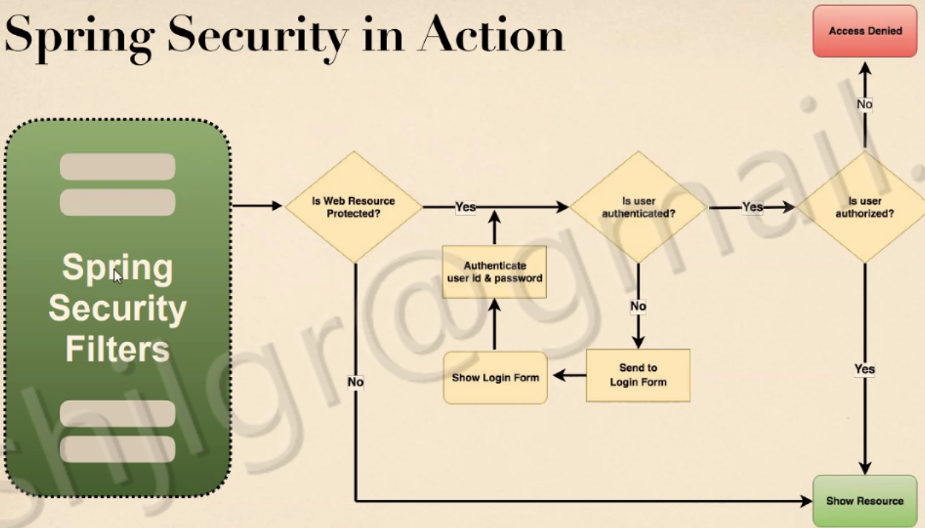
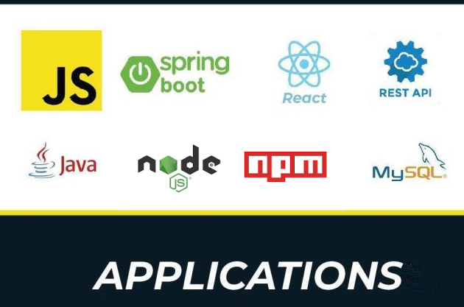
System Design
Block diagram/system architecture diagram of the system

Slide 9
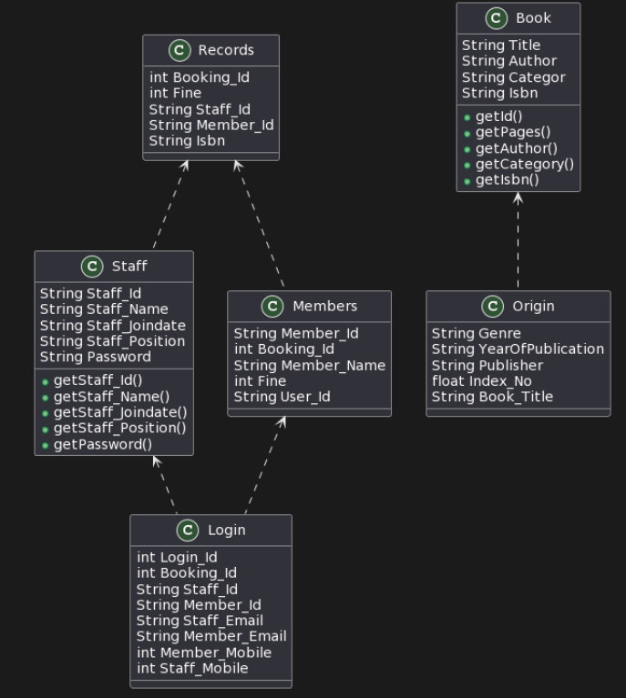
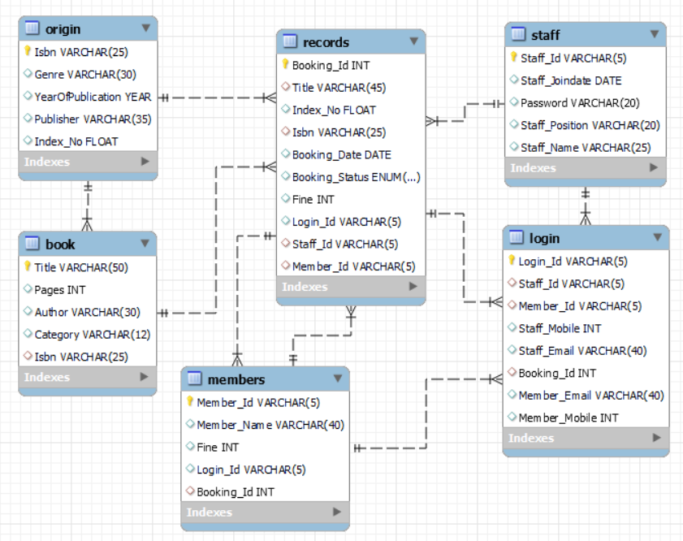
Classes and Methods
List of Classes and methods used

Slide 10
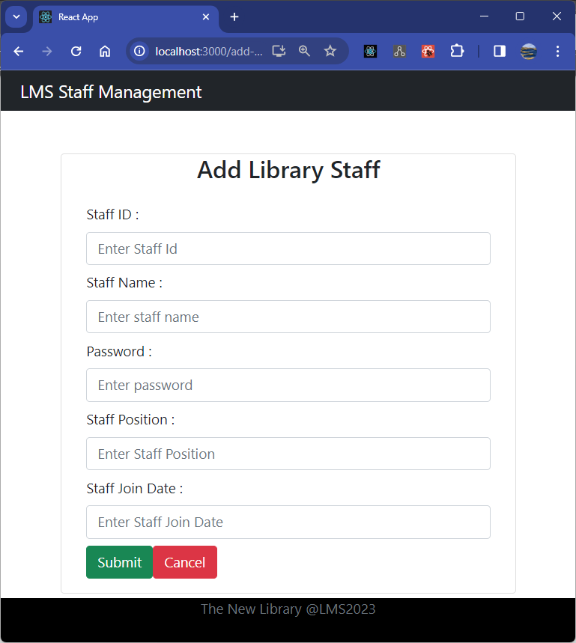
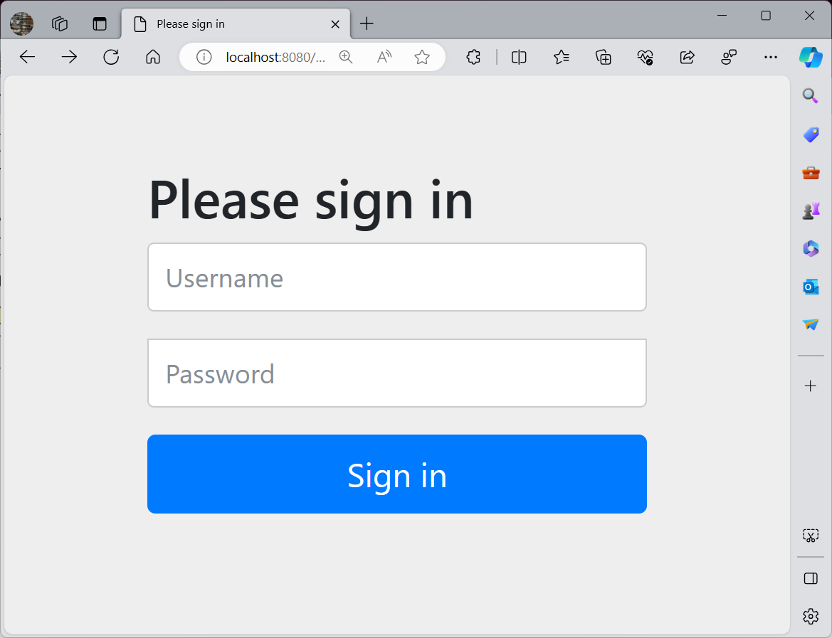
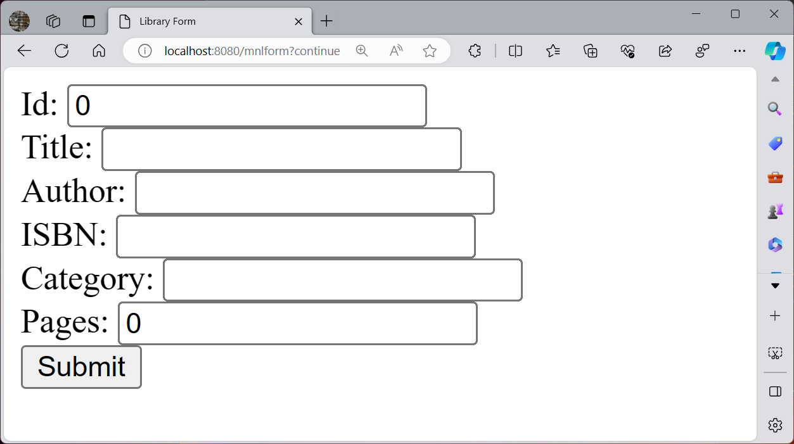
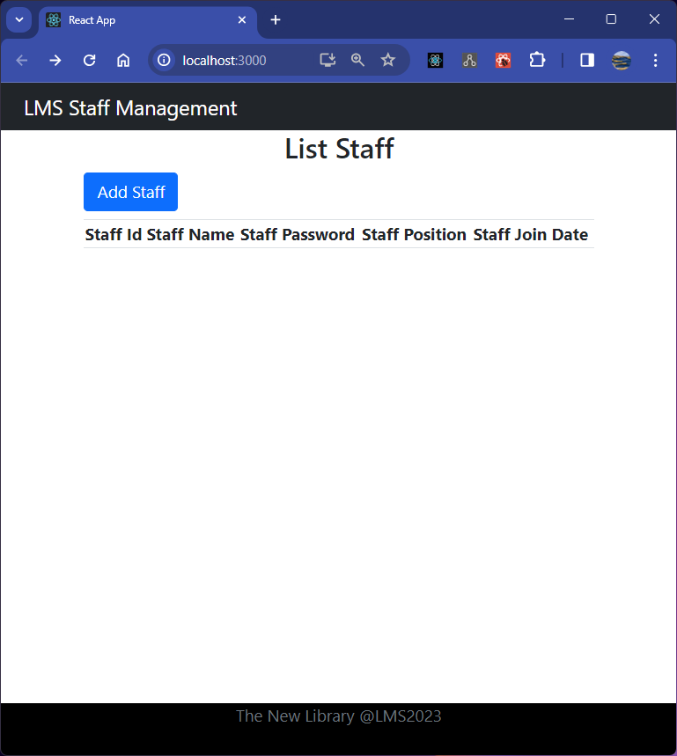
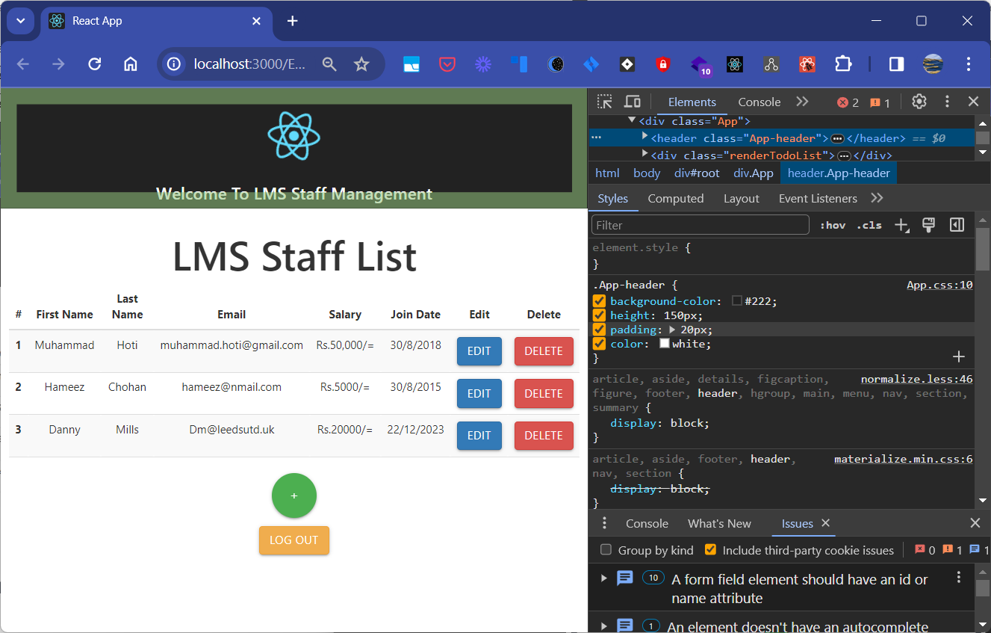
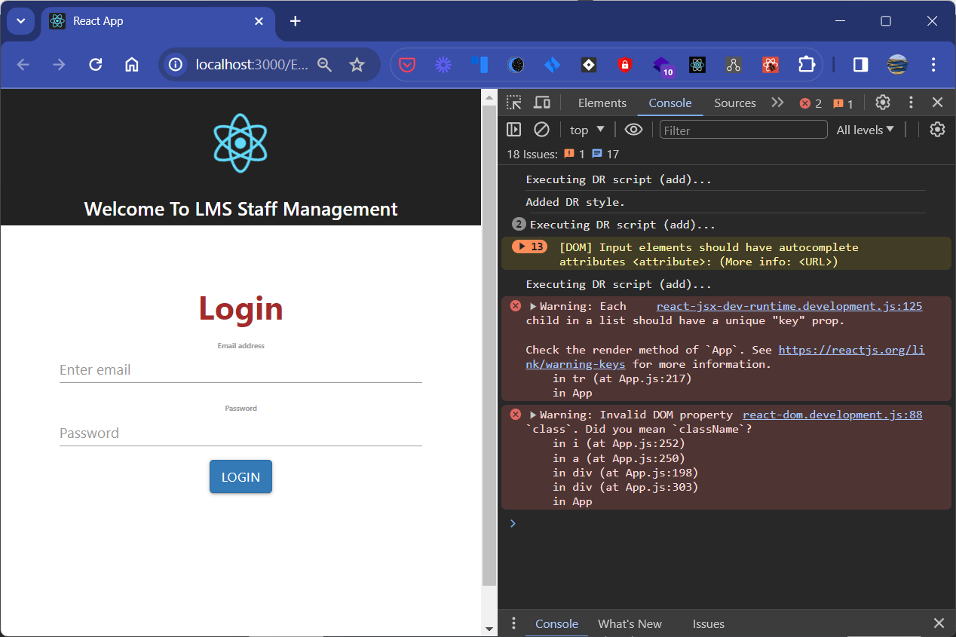
Screen Capture of Web Pages
List of Classes and methods used

Slide 11
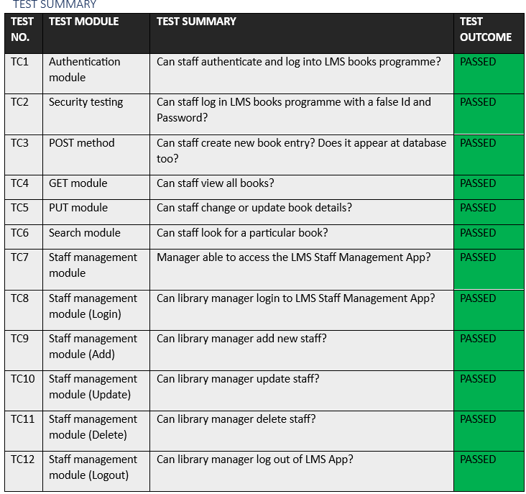
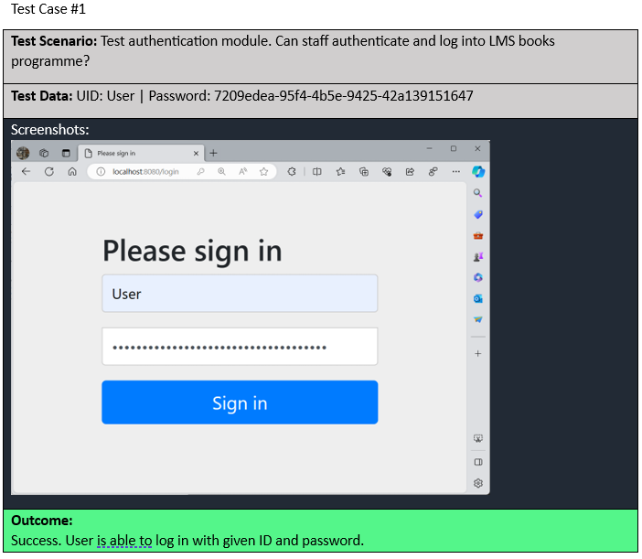
UAT Test Cases

Slide 12
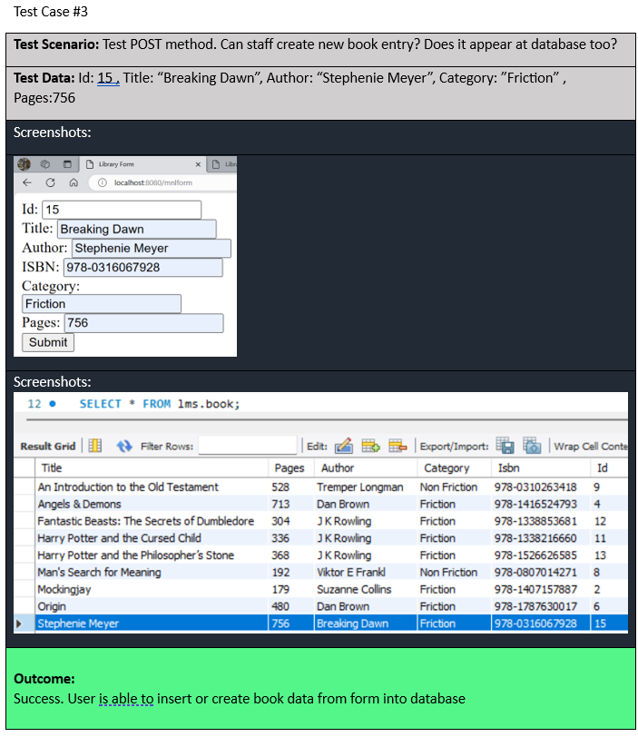
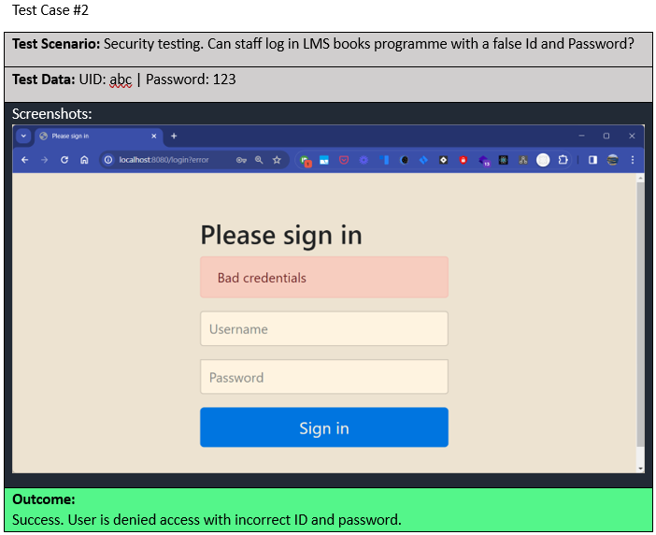
Project Results
Screenshots of all the evidences showing project outcome (Output messages, database entries etc)

Slide 13
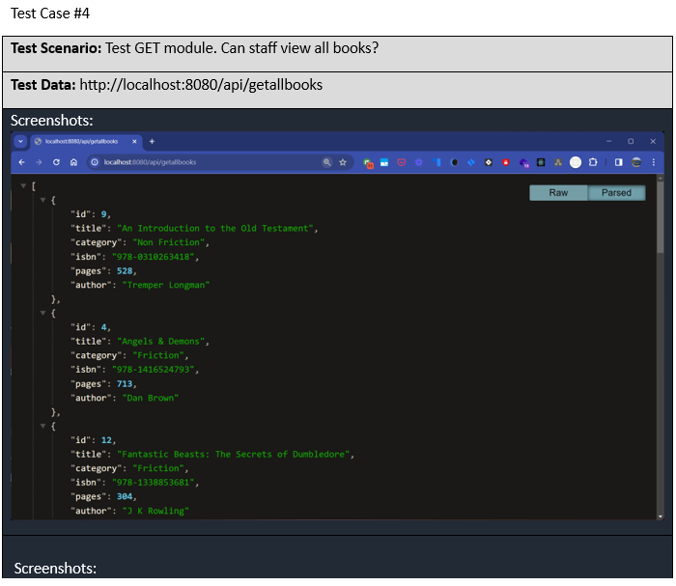
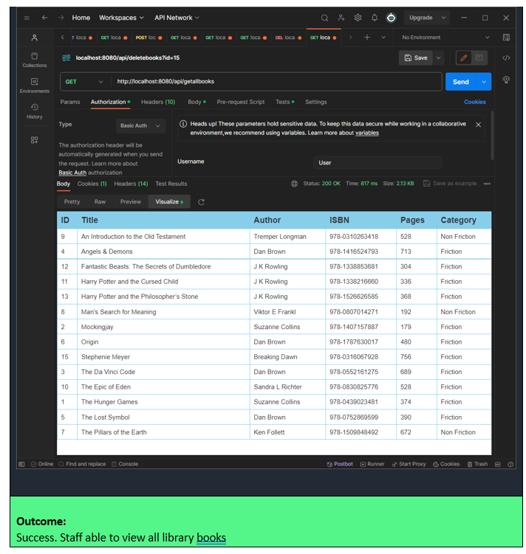

Slide 14
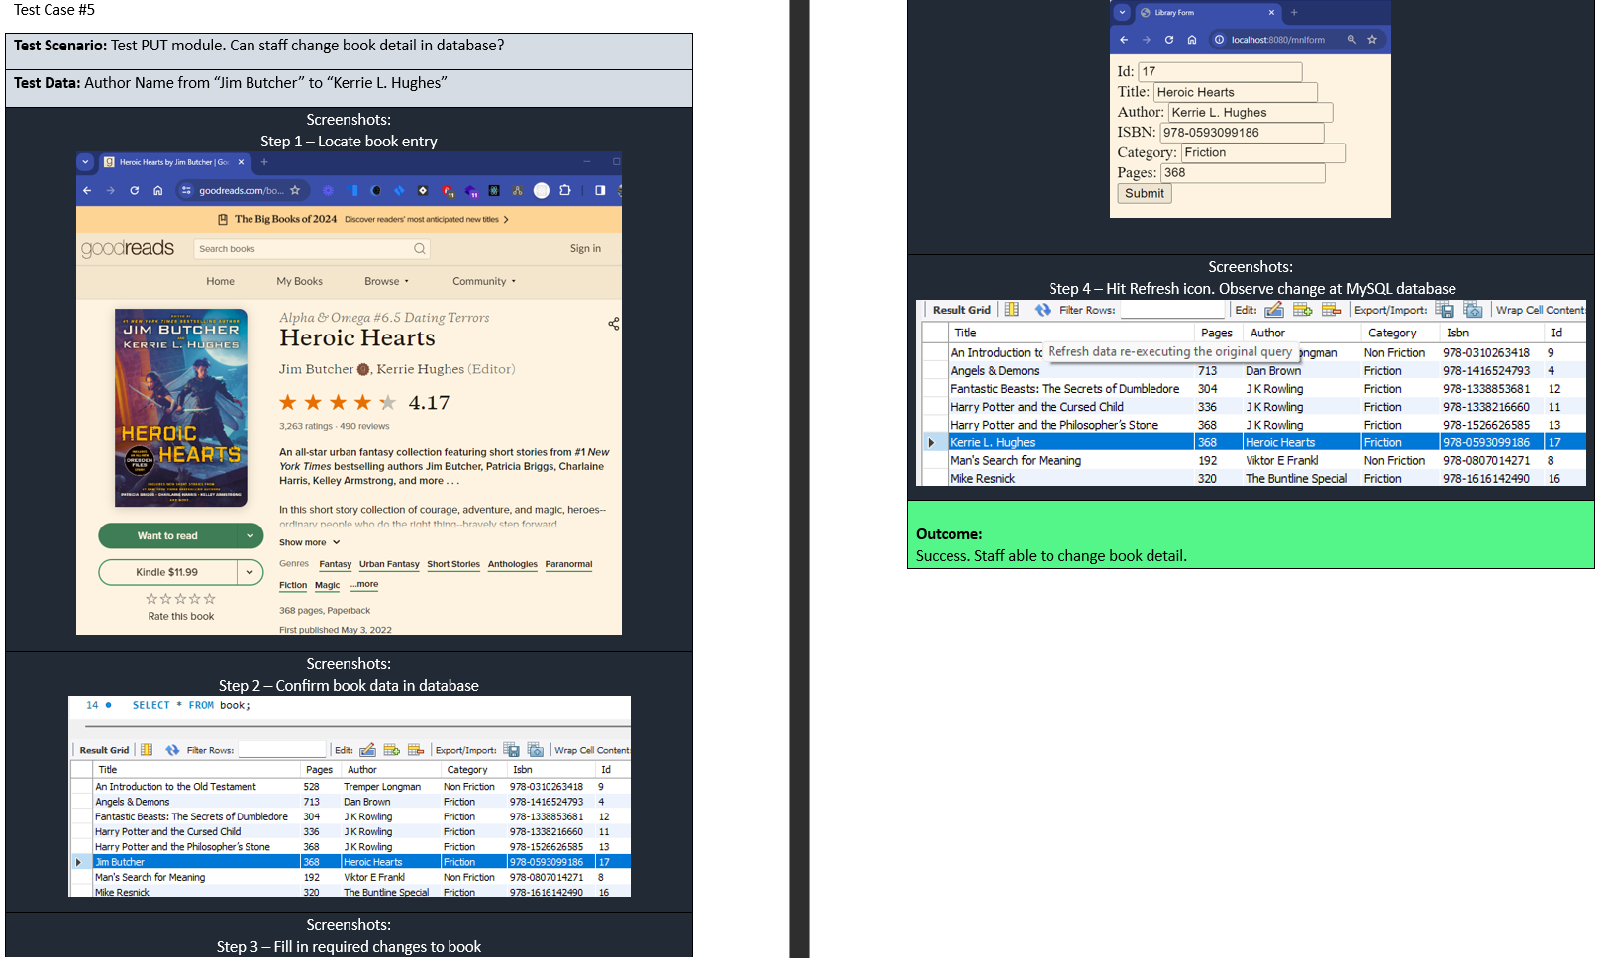

Slide 15
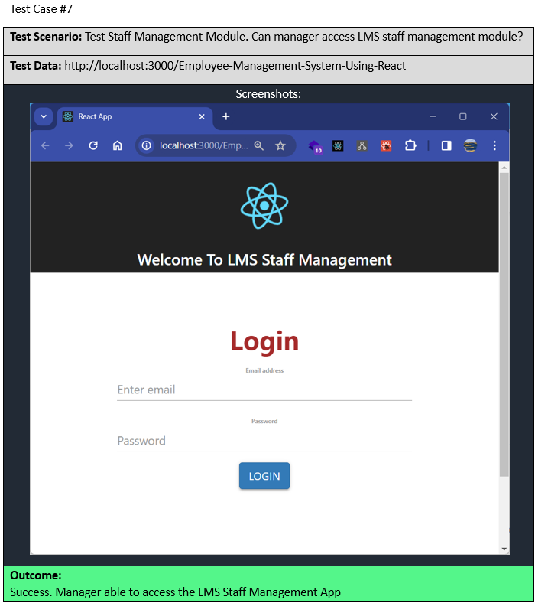
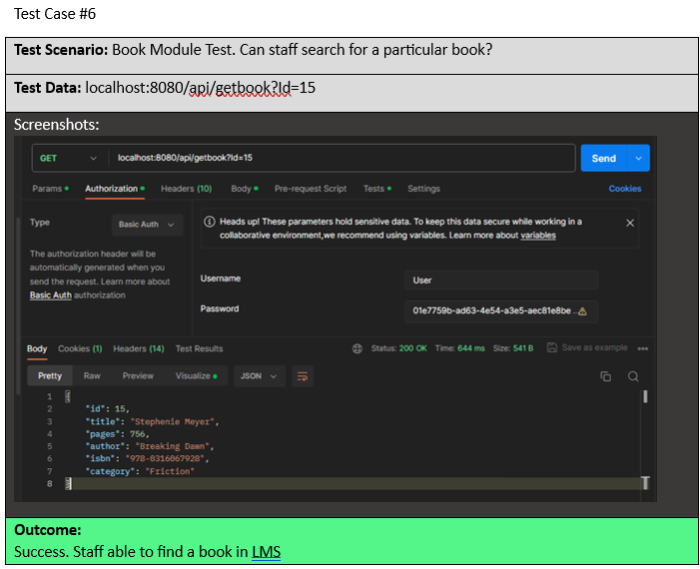

Slide 16
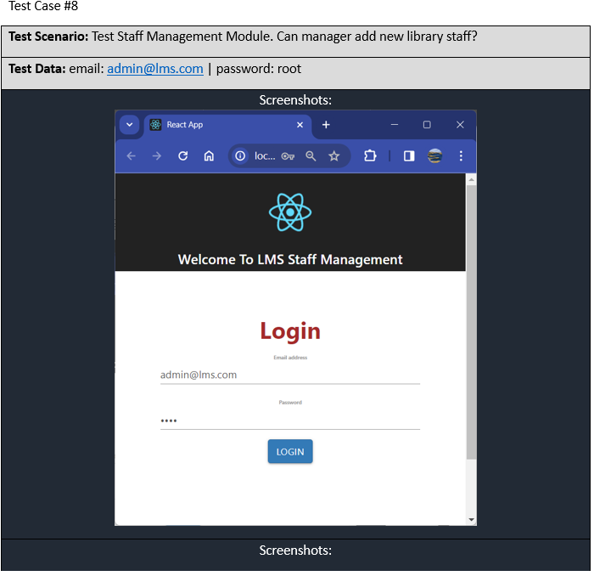
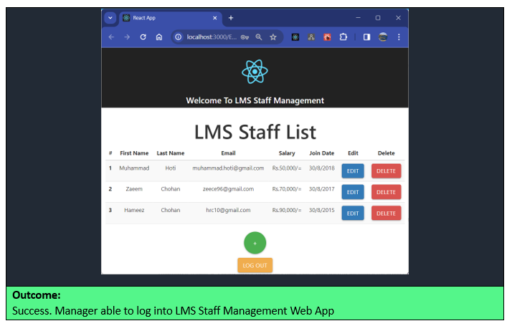

Slide 17
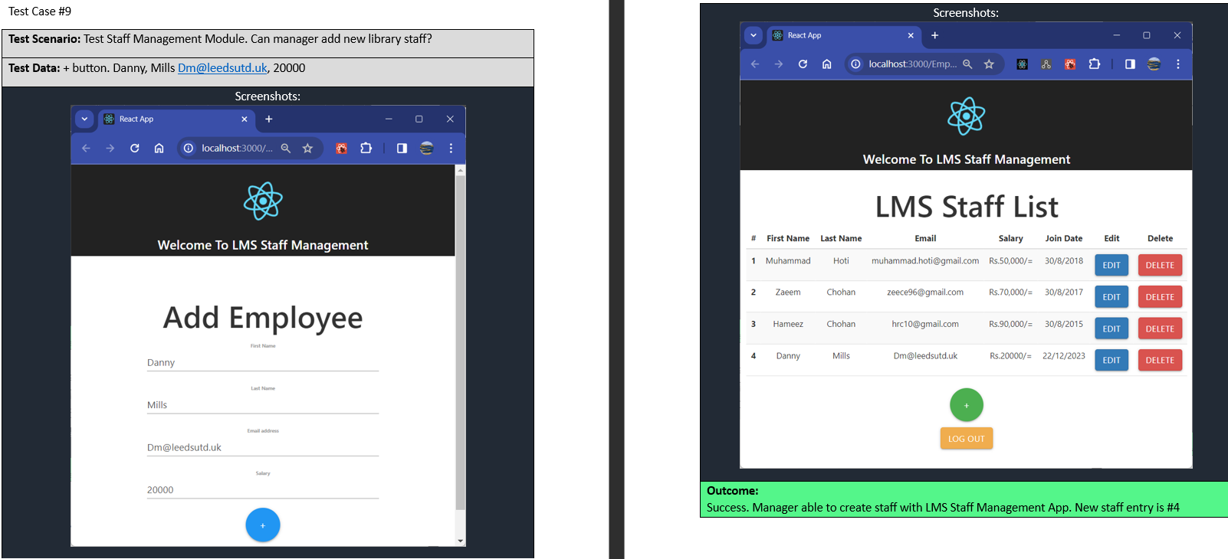

Slide 18
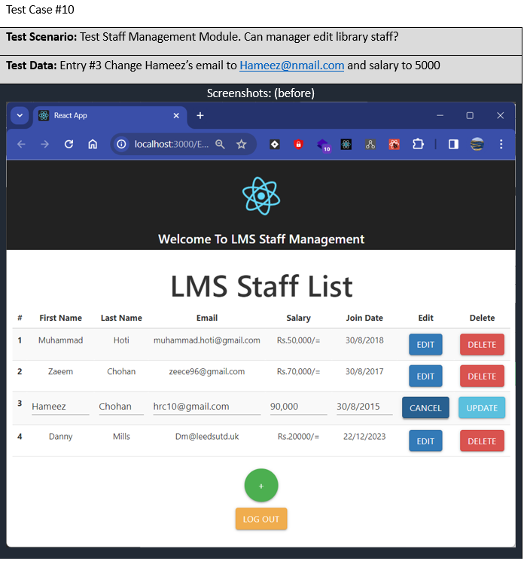
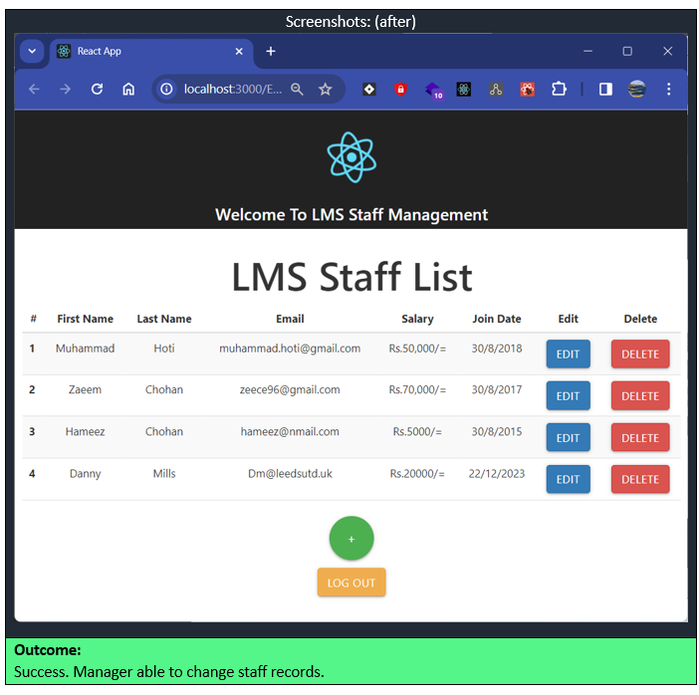

Slide 19
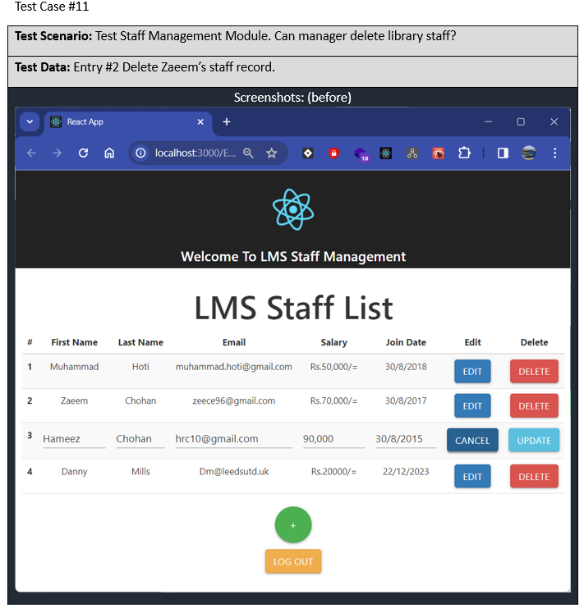
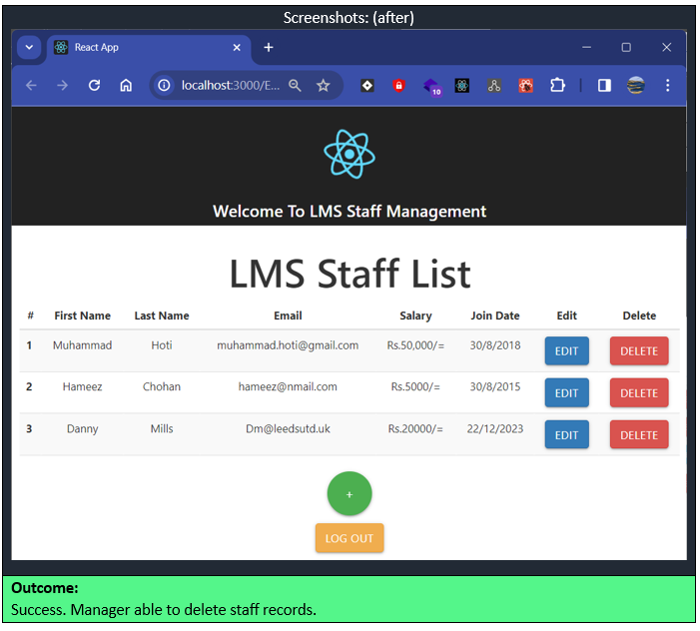

Slide 20
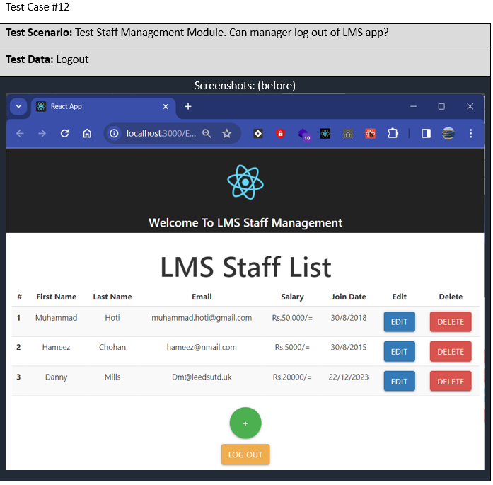
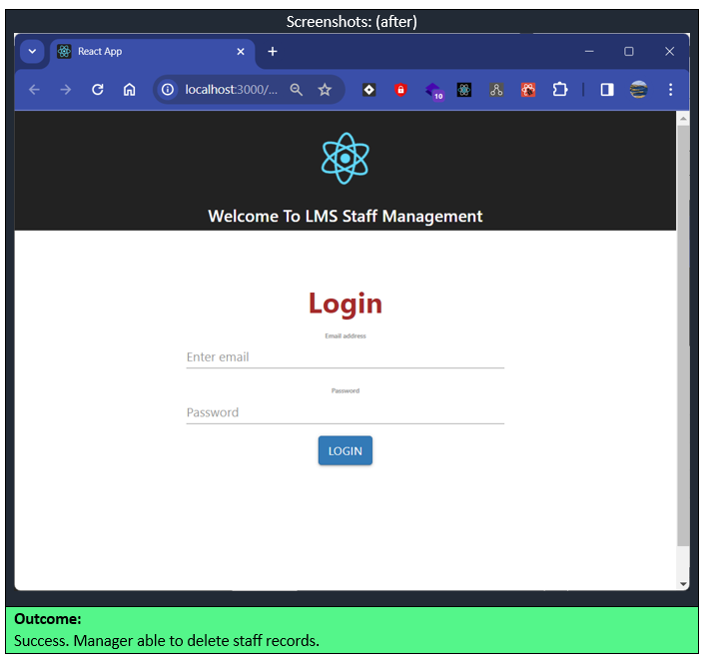

Slide 21
Proposed Improvements
Linking employee module to backend database. Currently is being separately managed by library manager with reference to db.
Having the book in book out module to help automate work processes. So book status get automatically updated to system
Have system to greet user. Which means accepting their log so that they may self-manage their information and update themselves if change in address or telephone number.
Have optional print out receipt should a book loan be obtained. This help user get track their return date and borrow date.
Trigger an email to near return date so members can avoid a library fine
Expand use to library table booking to members to facilitate best use of library resources.

Slide 22
List of References
List the websites, resources you used
https://stackoverflow.com/questions/67001182/module-not-found-error-cant-resolve-zlib
https://web3auth.io/docs/troubleshooting/webpack-issues#react-create-react-app
https://github.com/facebook/create-react-app/issues/11756
https://stackoverflow.com/questions/45980173/react-axios-network-error
https://bobbyhadz.com/blog/react-axios-network-error-stack-trace
https://stackoverflow.com/questions/70398678/i-tried-to-polyfill-modules-in-webpack-5-but-not-working-reactjs
https://www.educative.io/answers/what-is-typeerror-cannot-read-property-state-of-undefined
https://bobbyhadz.com/blog/npm-missing-script-start
https://answers.netlify.com/t/npm-err-missing-script-build/88337

Slide 23

Thank you..

